Slide 1
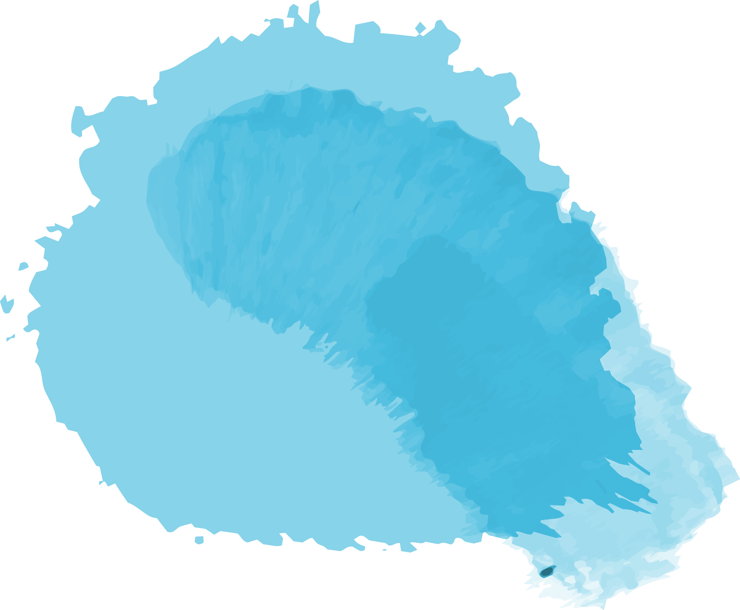

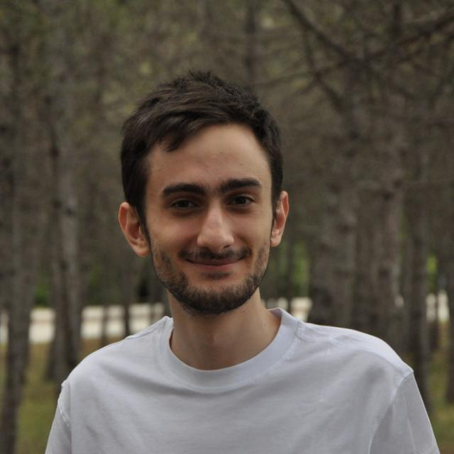


Neural Machine Translation Tool
Oğuz Kaan İmamoğlu
Data Science Intern
Bilkent University
Computer Science - IV

Slide 2
Project Definition
‘A language translation tool: By using different neural network approaches, a language transformation tool which will work on several languages’

Slide 3
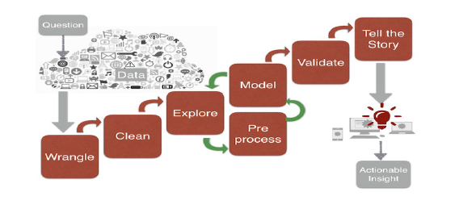
Steps of a Data Science Project

Slide 4


Steps of My Project
01
02
03
Prepare the Datasets
Extend the Datasets
Compose the Neural Network Model
Crawl the forms and collect their ID’S
Using ID’s and Jotform API, extract texts from forms
Generate a dataset for each language
By using Reccurent Neural Networks and attention mechanism, compose the Machine Learning Model to handle language translation task [1].
Test the model
See results are not accurate enough and notice datasets are too small for such a complicated NLP task.
Combine the prepared datasets with the datasets available on the internet [2].

Slide 5
04
Train NN Model
Train the model with new datasets for each 14 language.
Validate and test the models.
Obtain 14 models in total.
Each model can translate language ‘x’ to English
05
Design a User Interface
Design and implement an User Interface for the Language Translation Tool.

Slide 6
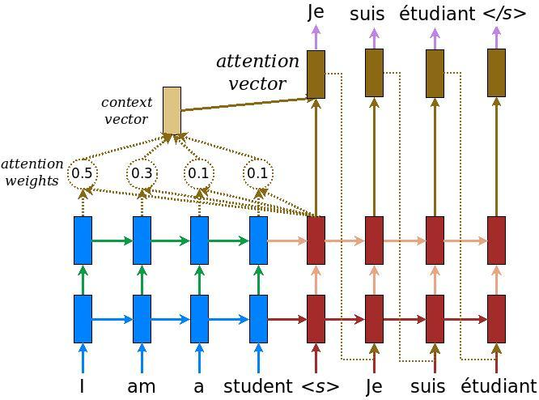
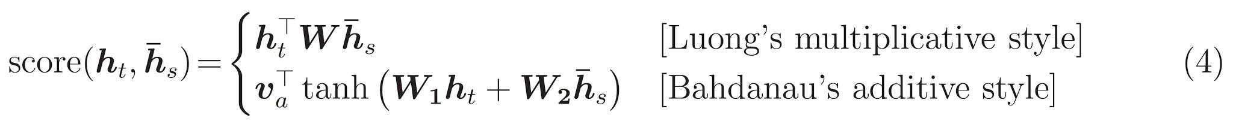
Model

Slide 7
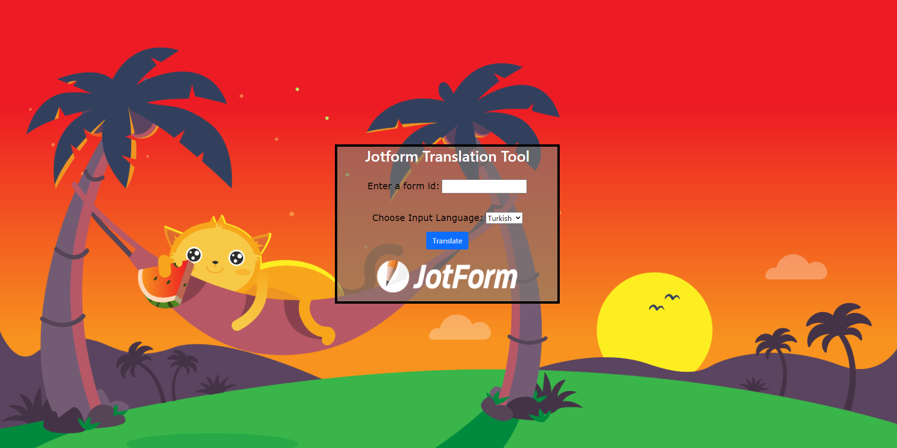

Slide 8
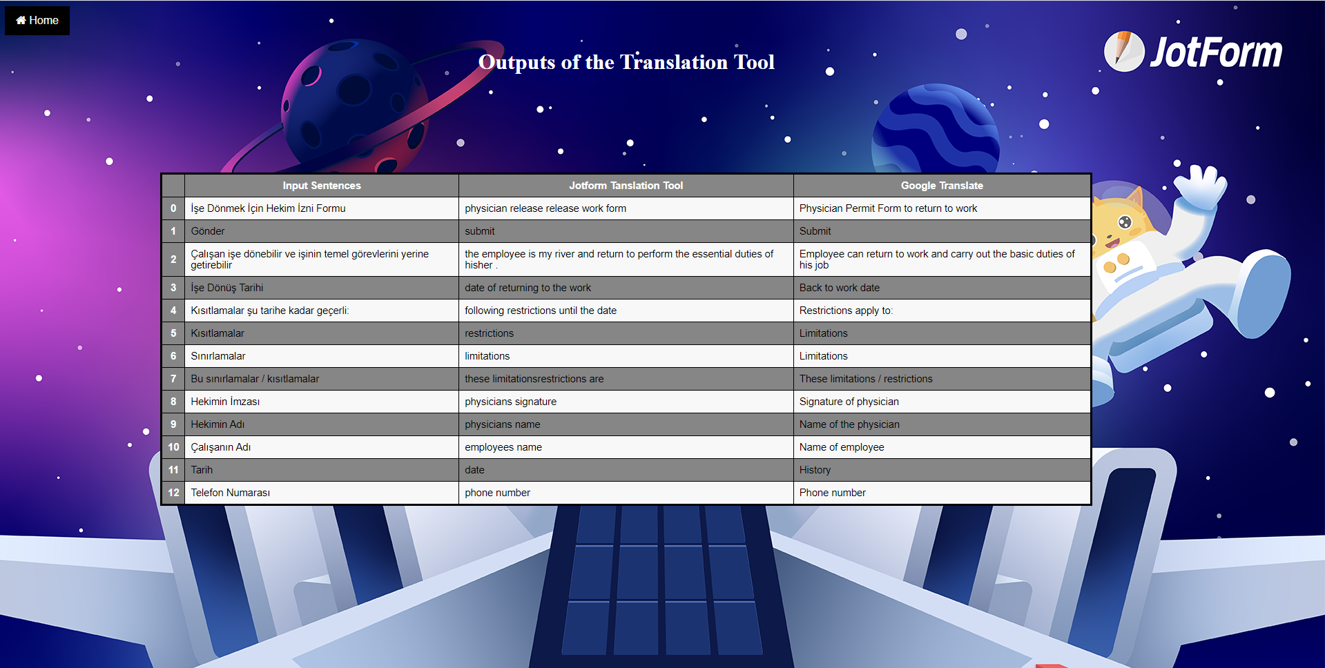

Slide 9
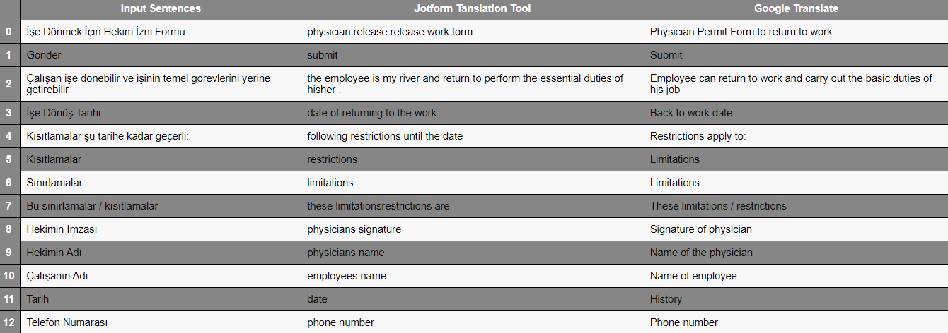
Results

Slide 10
Funny Blunders
Lütfen aşağıdakileri deneyimleyip deneyimlemediğinizi belirtin
please list the following symptoms
i acknowledge that the information i have provided above is correct and or what i do have care of your music can be true and are accurate.
Verdiğim bilgilerin doğru ve eksiksiz olduğunu kabul ediyorum.
Evden çalışabilir misiniz?
could you study the house ?

Slide 11
References
[1]"Neural machine translation with attention | Text | TensorFlow", TensorFlow, 2021. [Online]. Available: https://www.tensorflow.org/text/tutorials/nmt_with_attention. [Accessed: 07- Jul- 2021].
[2]"Tab-delimited Bilingual Sentence Pairs from the Tatoeba Project (Good for Anki and Similar Flashcard Applications)", Manythings.org, 2021. [Online]. Available: http://www.manythings.org/anki/. [Accessed: 07- Jul- 2021].

Slide 12
“Special thanks to my mentor, Ömer Orkun Akpınar

Slide 13
Thank You Jotformers !
It was a great experience for me to do an internship at Jotform

